Slide 1
A New Parent Training Resource: Helping Families See Possibilities in Employment
November 6, 2023
Sean Roy - TransCen

Slide 2
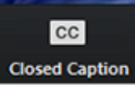

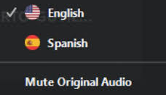
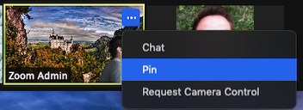
Using Closed Captioning
To start using CC, click the caption button
Uso de la interpretación de idiomas
Hagan clic en el icono de interpretación
Seleccionen “Spanish”
Después de seleccionar “español”, hagan clic "Mute Original Audio"
Using ASL
To pin the interpreter, hover over the video of the participant you want to pin and click ...
From the menu, click Pin.
Notes:
Para acceder al canal en español, van a ver en la banda o cinta negra un globo que indica "interpretation". Hagan click alli. Luego seleccionan español, y opriman donde dice "mute original audio". Esto último filtra completamente la presentación en inglés para que puedan escuchar con claridad a nuestro intérprete XXXXXX
Using ASL- we will pin the interpreter on our side, but you can do that:
To pin the interpreter, hover over the video of the participant you want to pin and click ...You will see three little dots over the person you would like to pin.
From the menu, click Pin.

Slide 3
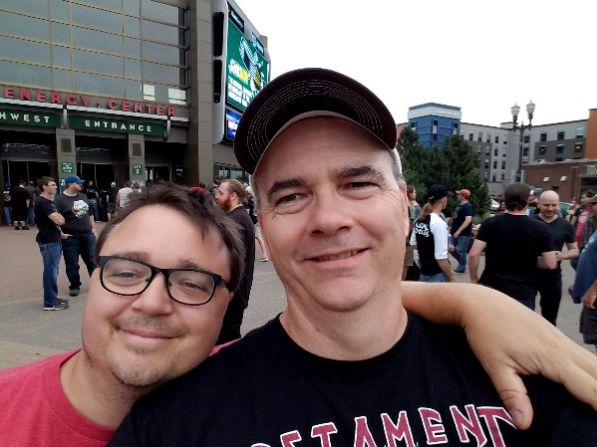
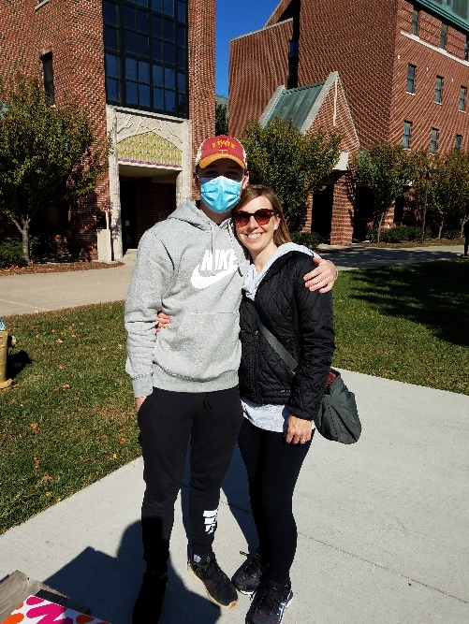

Sean Roy
Sibling of a younger brother with intellectual disabilities
Currently serving as the Chief Training and Innovation Officer for TransCen Inc.
Formerly the Transition Projects Director for PACER Center, a national non-profit serving families
National trainer on ACRE and a frequent speaker at disability employment and transition conferences
Strong interest in employment, staff development, family engagement, and raising expectations

Slide 4
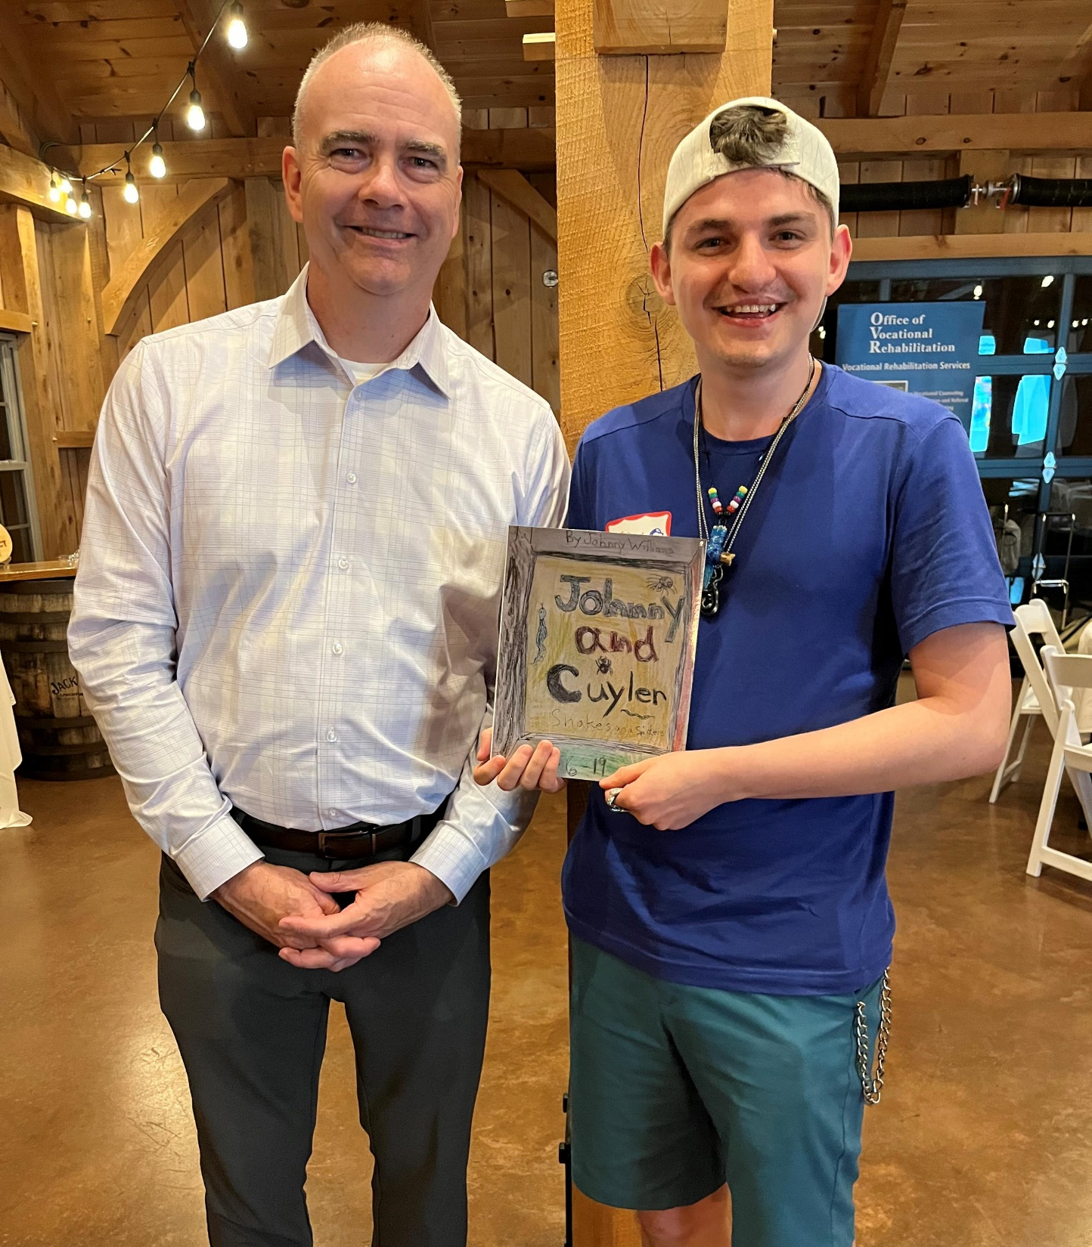
The Goal
To give families positive messages about employment and to offer strategies and tools so they may advocate for a strengths-based approach to employment planning.

Slide 5
What We Are Up Against
Deficit-based systems
Families getting mixed messages about CIE
Families being forced to choose (day program or CIE)
Inflexible service options
Myths about Social Security benefits
The school-to-day program pipeline
Lack of capacity to provide quality employment services

Slide 6
Imagine the Possibilities:
A Path to Employment Success
Module 1: Employment as Part of a Good Life
Presenters: add information such as presenter’s names, location, date or event.

Slide 7
Module 1 Agenda
Employment core concepts
Why is work important?
Examining expectations
Taking a strengths-based approach
Building a vision
Questions and connections
Remember to use your worksheet as we move along

Slide 8
WORKSHEET QUESTION 1
What do you hope adult life will look like for your family member?

Slide 9

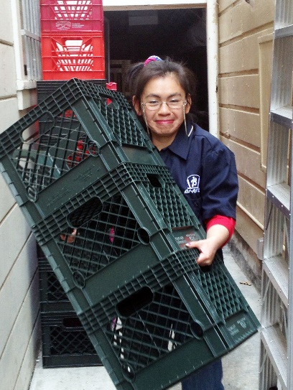




Today, People with Disabilities…

Slide 10
But There is Still Work to be Done…
There is still a long way to go before people with disability experience equality of opportunity in the US.
Employment rates
Poverty
Housing options
Social, recreational, relationships
A respected voice
Determine own futures

Slide 11
Employment:
So Much Is Possible

Slide 12
Employment: Core Concepts
1
2
Everyone can work!
Work looks differently for everybody
Employment should be rooted in what your family member wants to do
3

Slide 13
“Employment First”
Employment in the general workforce is the first and preferred outcome in the provision of publicly funded services for all working age citizens with disabilities, regardless of level of disability.
APSE Statement on Employment First
Chosen – Job is based on what a person wants to do.
Integrated – Alongside those without disabilities, with opportunities to interact
Employment – In the general workforce, on the payroll of a business or self-employed
Minimum Wage – At or above minimum wage or at industry standard wage

Slide 14
Why Should Your Family Member Work?
“The growth in his personal development, confidence and maturity became apparent very soon after he started working. Everyone in his family took notice and was delighted with the happy adult my son had become.”
– Bay Area Parent –
It is what is expected of adults
Socialization
Self-worth (dignity)
Purpose
Money
Promotes mental health
Because they can!

Slide 15
Seeing Your Family Member in a New Way

Slide 16
How do We Define Expectations?
“Expectations”
are a belief that someone will or should achieve something; that something will happen or is likely to happen in the future.
“High Expectations”
are the belief that a person with a disability (or other barrier) can achieve the same life and have the same life choices as everyone else.
Notes:
Judith

Slide 17
Where Do Low Expectations Come From?
Society’s perceptions about the impact of disability
Feelings about having a family member with a disability
What we are told by others
The secret is seeing that people with disabilities can do great things, and not letting other people’s ideas impact your family member’s ability to make lives for themselves.

Slide 18
Think back…
  Experiences and perceptions of individuals with disabilities before your child was born
  Experiences with your child’s pediatrician
  Experiences your child’s kindergarten teacher
  Experiences with your friends as your children aged

Slide 19
Examining the Roots of Our Expectations
Name 2 individuals or situations that helped you have high expectations for your student’s education future.
Name 2 situations/messages that negatively impacted your expectations for your student’s education future.
Notes:
Ask folks to share out after each.

Slide 20
The Importance of Having High Expectations
Families set the bar for how the rest of the world sees their family member with a disability.
Avoiding restrictive programs or placements
Lives lived in the community
Lives based on the dreams your family member has for themselves
Seeing that risk is good and failure can be constructive

Slide 21

The Balancing Act

Slide 22

Patience is Key

Slide 23

What is Success?
Think of a couple things that you would not be successful at on your first try.
Success in employment is an ongoing process and will look different for everyone.
Hours worked
Tasks
Tolerance
Recognize and celebrate progress!!

Slide 24
HELPFUL TOOL
Positive Personal Profile
Helps take inventory of all the things a person brings to employment. Focus on strengths and interests, not deficits.

Slide 25
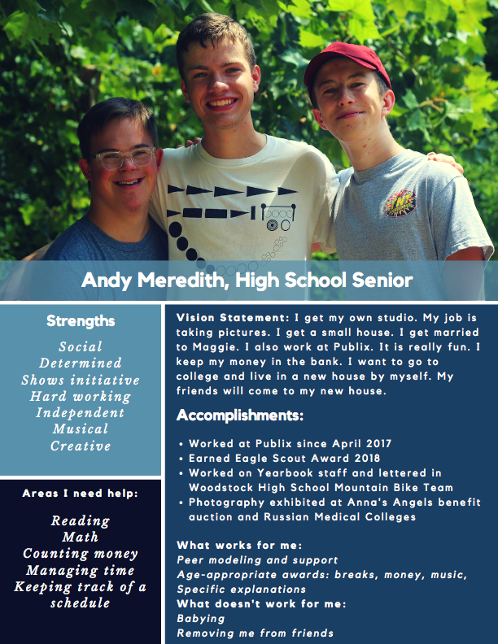
Building a Vision Statement
https://hdi.uky.edu/employment-checklists
(Scroll down to “Vision Statement Template”)

Slide 26
Takeaways
Everyone can work
There are many benefits to employment
Family expectations are influential
Take a strengths-based approach to employment

Slide 27
Imagine the Possibilities Modules
Module 1: Setting a vision for a “good life” and examining expectations.
Module 2: Preparing youth and young adults for employment success.
Module 3: Empowering youth and young adults while addressing family concerns.

Slide 28

Questions

Slide 29
Contact Information
Presenters, add your contact information here so attendees can reach you with any questions.

Slide 30
Imagine the Possibilities:
A Path to Employment Success
Module 2: Preparing for Employment Success
Presenters: add information such as presenter’s names, location, date or event.

Slide 31
Module 2 Agenda
The importance of a good job match
Work experiences are key
A brief look at Social Security benefits and employment
Exploring employment supports
Questions and connections
Remember to use your worksheet as we move along

Slide 32

The Goal: A Good Job Match
Beware of these habits:
Picking jobs “nobody else wants”
Picking convenient options
Offer same work experience year after year
Exclude certain populations (those with more significant support needs)

Slide 33



Everyone Needs Skills
“Teach real things.” John Elder Robison

Slide 34
WORKSHEET QUESTION 2
What is your family member’s greatest skill or attribute?

Slide 35
The Power of Work Experiences
One of the best predictors of employment success for people with disabilities is having meaningful work experiences while in high school.
Informational interview
Job Shadowing
Volunteering
Internships
Paid entry-level job

Slide 36
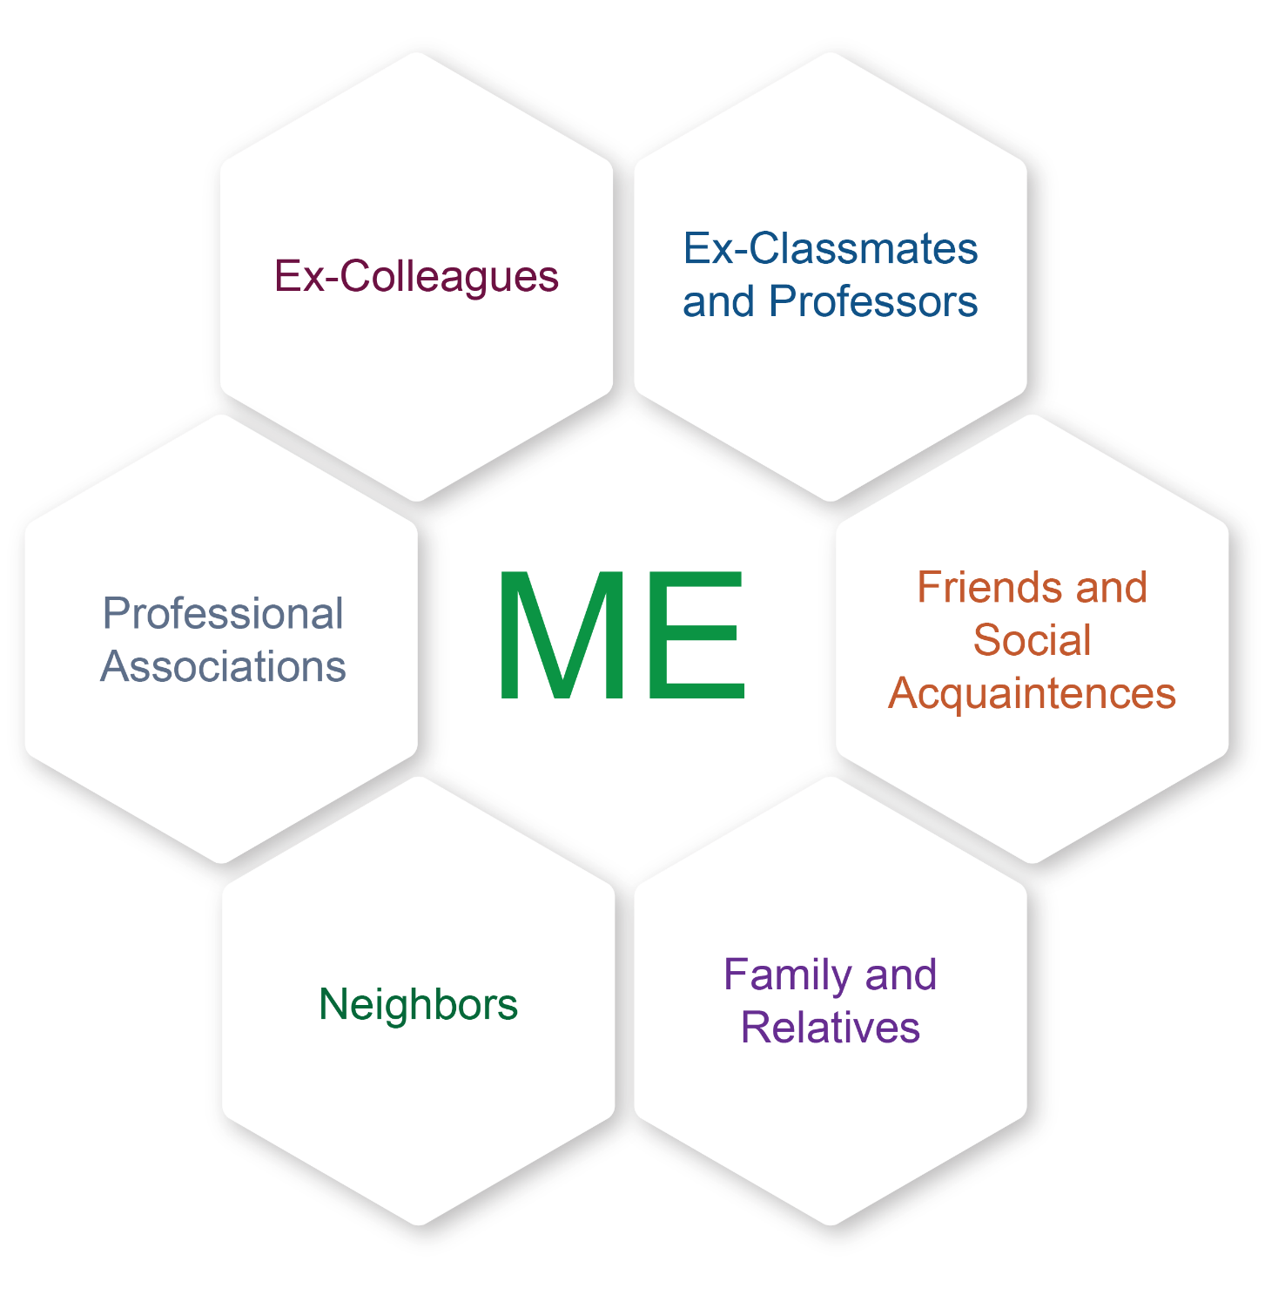
Using Your Networks
Use the people you know to help find work experience opportunities.
Friends
Family
Places you do business
Neighbors
People you are in clubs with, worship with, or serve with

Slide 37
Building Responsibility
Finding ways for young people to have responsibilities helps them be good employees.
Chores
School work
Soft Skills
It’s OK for young people to take risks and to experience failure. The goal is to have them give a good effort.

Slide 38







Getting Involved

Slide 39
School and Employment
The high school and transition years are the perfect time to focus school programs on preparing for employment.
Are skills needed for work included as goals in the IEP?
Career exploration
Functional skills and soft skills
Work experiences
Quick Tip: Parent advocates can help coach you on asking for employment-focused activities in the IEP.

Slide 40
Myths about Employment
Misinformation and misunderstanding can hold us back from considering employment.
People with disabilities don’t work fast enough (MYTH)
Employees with disabilities won’t be accepted by co-workers (MYTH)
Sheltered work is safer than community jobs (MYTH)
People who leave workshops lose their friends (MYTH)
People with significant disabilities don’t need to work (MYTH)
Don Lavin – Strengths at Work

Slide 41
Social Security Benefits: Myths and Resources
MYTHS
Getting students on SSI will take care of everything
People who choose work will lose disability and healthcare benefits
People can live independently in the community on what SSI provides
RESOURCES
WIPA (Work Incentive Planning and Assistance) projects
A Certified Work Incentive Counselor (CWIC) can help you better understand the intersection between benefits and employment
Contact your state’s vocational rehabilitation program for info

Slide 42
Employment Supports
Vocational Rehabilitation – Coordinates many of the services. Should be brought in 3 years prior to school exit.
DD Waiver Services – Most commonly results in a “day service” – families need to push for employment services
Keep in mind: Individuals with disabilities do not need formal services to be employed.

Slide 43
Maximizing Services
Be the keeper of the vision
Your loved one should be the driver of the vision
Services may “work for the client” but families have to “work with the services” to make it a success
Know your rights and tell your story
Families have always been the driver of change!!

Slide 44
WORKSHEET QUESTION 3
What do you need to feel hopeful and energized about your family member’s employment future?

Slide 45
Takeaways
Work experiences can can lead to a good job match
Use chores and school/community activities to build work skills
Benefits counseling is available
Explore employment supports through your state’s vocational rehabilitation program

Slide 46
Imagine the Possibilities Modules
Module 1: Setting a vision for a “good life” and examining expectations.
Module 2: Preparing youth and young adults for employment success.
Module 3: Empowering youth and young adults while addressing family concerns.

Slide 47
Questions

Slide 48
Contact Information
Presenters, add your contact information here so attendees can reach you with any questions.

Slide 49
Imagine the Possibilities:
A Path to Employment Success
Module 3: Empowering Youth and Addressing Concerns
Presenters: add information such as presenter’s names, location, date or event.

Slide 50
Module 3 Agenda
The importance of self-determination
The elements of self-determination
Addressing your questions and concerns
Setting your action steps
Questions and connections
Remember to use your worksheet as we move along

Slide 51
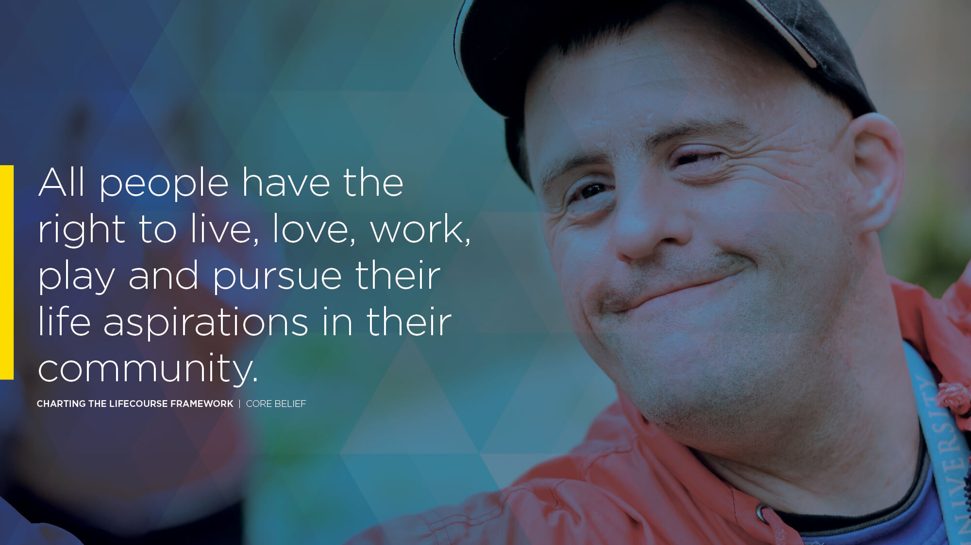
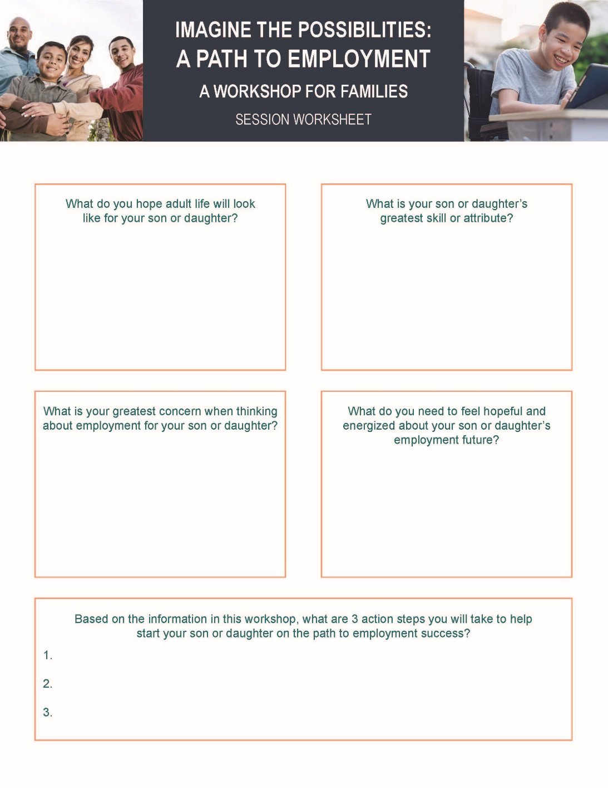
WORKSHEET QUESTION 1
What do you hope adult life will look like for your family member?

Slide 52
Self-Determination and Self-Advocacy
Self Determination - Self-determination is generally understood to be the ability for an individual to be the primary decision maker in regards to the path of their life.
Self-Advocacy - Self-advocacy is the ability to assert or communicate one’s preferences, desires, and needs effectively.

Slide 53
Why is Self-Determination Important?
One aspect of living a “good life” is having the ability to make decisions for yourself.
Enhances quality of life
Increases life satisfaction
Increases self-confidence
Linked to improved employment outcomes

Slide 54
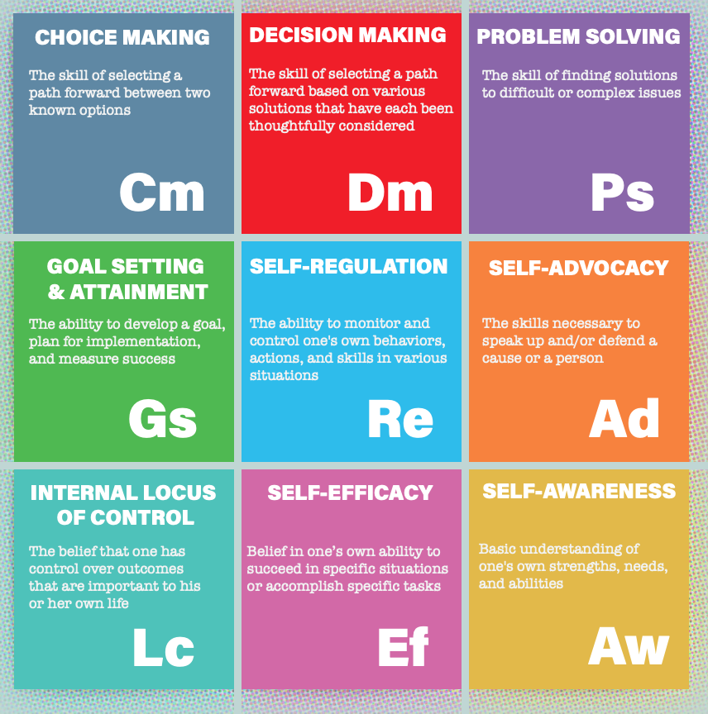
Elements of Self-Determination

Slide 55
Group Question
Think back to your transition years (12-22). How did you develop skills around these “elements of self-determination”?

Slide 56
Strategies to Address the Elements of Self-Determination
Choice Making
The skill of selecting a path forward between two known options
“Would you like to go out to eat or have chicken on the grill?”
Decision Making
The skill of selecting a path forward based on various solutions that have each been thoughtfully considered.
“Your room needs to be cleaned by Sunday at 6:00. It’s up to you to decide how to get it done between now and then.”
Problem Solving
The skill of finding solutions to difficult or complex issues.
Get your student involved in home-based problem solving such as coordinating a complex schedule or developing a menu on budget.”

Slide 57
Strategies to Address the Elements of Self-Determination
Goal Setting and Attainment
Use the I’m Determined Goal Plan to help the student set small goals for school achievement or physical activity.
Self-Regulation
The ability to monitor and control one’s own behaviors, actions, and skills in various situations
Self-Advocacy
The ability to speak up and to defend a cause or a person.
Help the student identify a cause they are passionate about and how to become involved in the community.
Develop strategies, such as a keyword, that helps the student recognize when they are exhibiting certain behaviors. Seek opportunities to increase things that trigger positive behaviors.
The ability to set a goal, plan for implementation, and measure success.
Notes:
Could we tie in the trajectory here, too? Similar concepts, just a bit of a different lay out. And the CtLC goal attainment tool?

Slide 58

The Final Elements of Self-Determination
Strategies to Address the Elements of Self-Determination
Internal Locus of Control
Provide plenty of opportunities for the student to practice age-appropriate ways to lead their own lives. Help student see the connection between their decisions and the outcomes they wanted.
Self-Efficacy
Belief in one’s own ability to succeed in specific situations or accomplish specific tasks.
Self-Awareness
Basic understanding of one’s own strengths, needs, and abilities.
Help the student articulate what their disability is and how it impacts them in education, employment, and social situations.
Celebrate when new tasks or skills and learned and treat unsuccessful attempts as natural steps in the process.
The belief that one has control over outcomes that are important to his or her life.
Notes:
Could we tie in the trajectory here, too? Similar concepts, just a bit of a different lay out. And the CtLC goal attainment tool?

Slide 59
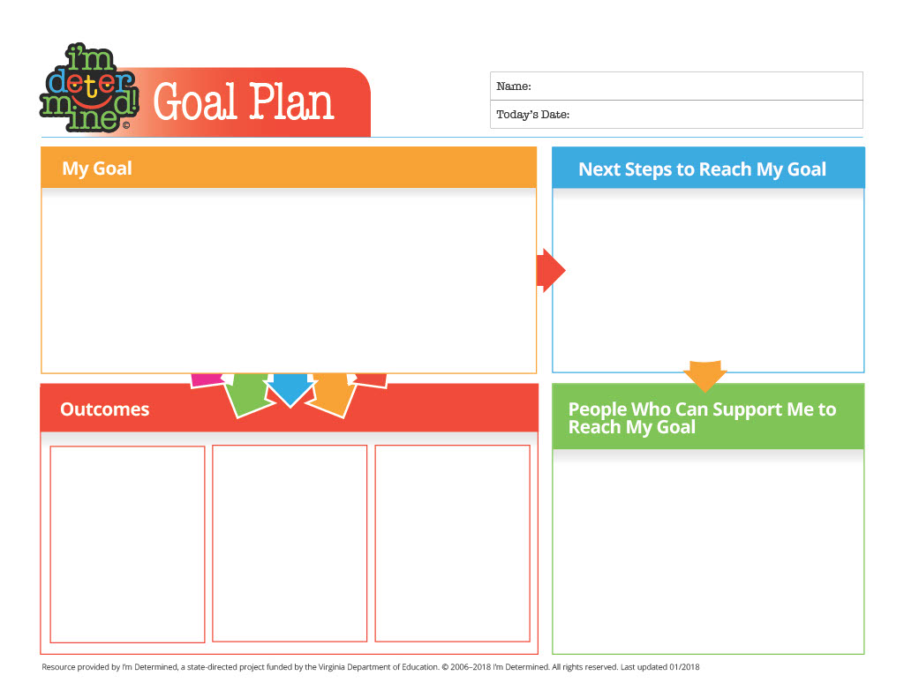
I’m Determined
Goal Template
https://www.imdetermined.org/

Slide 60
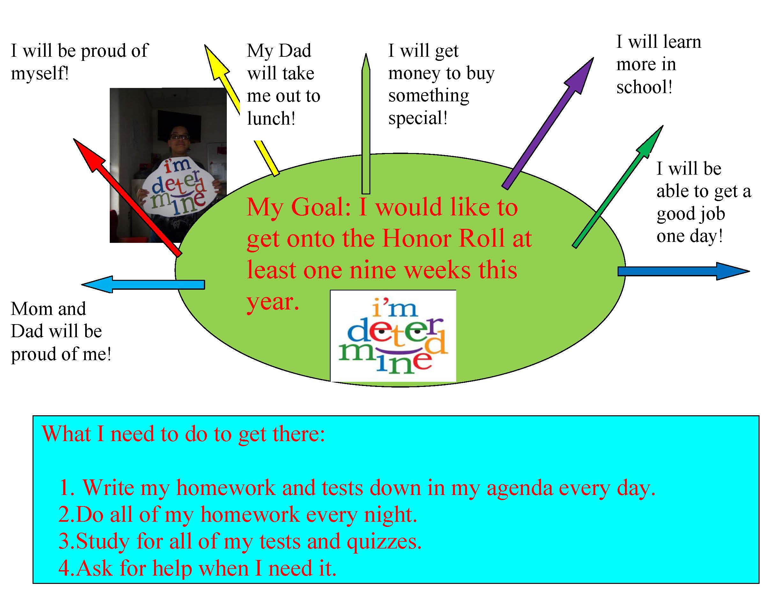

Slide 61
Having Questions or Concerns is Normal
When thinking about a real job in the community for your family member, is there anything that makes you worried or concerned?
Vulnerability
Safety
Can they do the job?
Who will hire them?
Will they lose benefits?

Slide 62
WORKSHEET QUESTION 4
What is your greatest concern when thinking about employment for your family member?

Slide 63
Action Steps: Getting Started

Slide 64
Possible Next Steps
Set the expectation that employment will be part of the future
Help your student explore interests
Make sure employment-related goals are in the IEP
Community-based work experiences last 2 years of HS

Slide 65
More Next Steps
Talk about disability disclosure with your student
Learn about skills needed to do jobs they are interested in
Increase responsibility at home
Ask about vocational rehabilitation services

Slide 66
WORKSHEET QUESTION 5
Based on the information in this workshop, what are 3 action steps you will take to help start your family member on the path to employment success?

Slide 67
Takeaways
Self-determination includes skills that allow individuals with disabilities to take control of their employment future
Having questions and concerns about employment is normal
Plan your action steps. Great things are ahead!

Slide 68
Imagine the Possibilities Modules
Module 1: Setting a vision for a “good life” and examining expectations.
Module 2: Preparing youth and young adults for employment success.
Module 3: Empowering youth and young adults while addressing family concerns.

Slide 69
Questions

Slide 70
Contact Information
Presenters, add your contact information here so attendees can reach you with any questions.

Slide 71
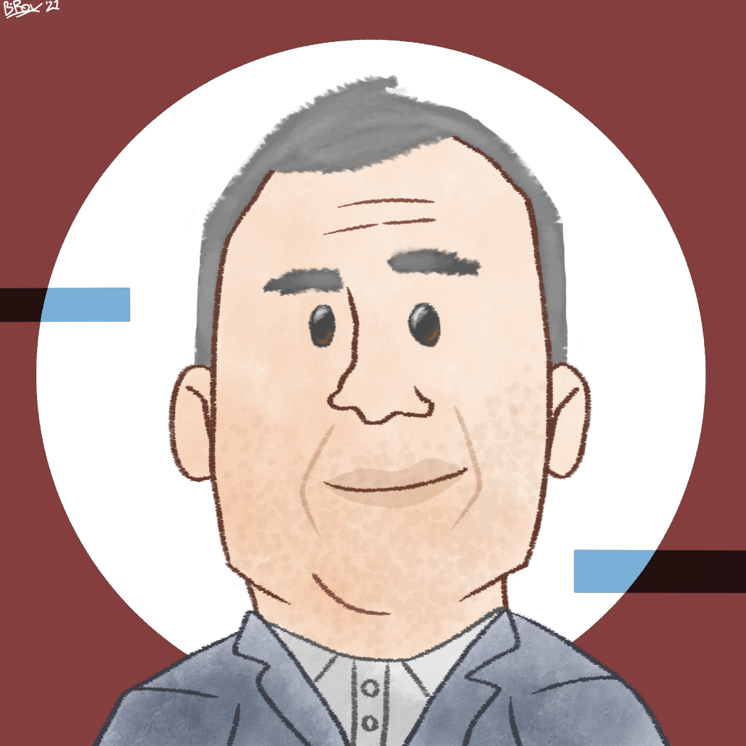
Contact
Sean Roy
sroy@transcen.org
www.transcen.org

