Slide 1
Connection and Community: A social media guide to enhance engagement
February 28, 2022 | PAGE 1
RAISE CENTER

Slide 2
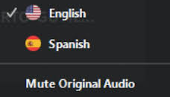
Using Closed Captioning
To start using CC, click the caption button
Uso de la interpretación de idiomas
Hagan clic en el icono de interpretación
Seleccionen “Spanish”
Después de seleccionar “español”, hagan clic "Mute Original Audio"
Using ASL
To pin the interpreter, hover over the video of the participant you want to pin and click ...
From the menu, click Pin.
Notes:
Para accede al canal en español, van a ver en la banda o cinta negra un globo que indica "interpretation". Hagan click alli. Luego seleccionan español, y opriman donde dice "mute original audio". Esto último filtra completamente la presentación en inglés para que puedan escuchar con claridad a nuestro intérprete XXXXXX
Using ASL- we will pin the interpreter on our side, but you can do that:
To pin the interpreter, hover over the video of the participant you want to pin and click ...You will see three little dots over the person you would like to pin.
From the menu, click Pin.

Slide 3
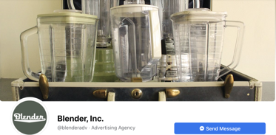
Let’s be friends (2 of 29)
February 28, 2022 | PAGE 2
RAISE CENTER
Notes:
Katy - VP and COO at Blender, Inc. Graduated from Point Park University with a degree in PR and Advertising. Hootsuite certified social media manager with eight years of experience and a passion for helping others use social media for good.
Blender - Established in 2004 to “do good work for organizations that do good works.” Blender is the home of bold ideas, smart strategies, and people who love what they do. Work with our region’s leading nonprofits, education, and human service entities. Through communication, messaging, social media, graphic design, website creation, and marketing campaigns, we’ve played a small role in helping improve people’s lives.

Slide 4
United Way’s #IWantToWork (3 of 29)
February 28 | PAGE 3
RAISE CENTER
Notes:
Blender was honored with the 2017 PRSA Renaissance Award for United Way of Southwestern Pennsylvania’s #IWantToWork self advocacy campaign that empowered young adults with disabilities to use social media to connect with legislators and create legislative change.

Slide 5
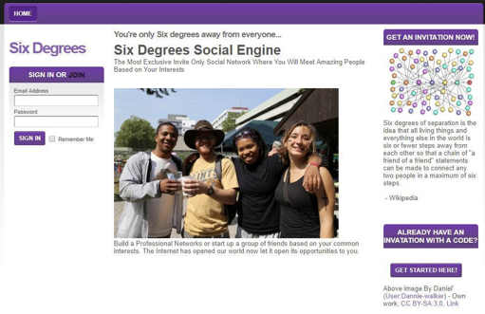
Rise and role of social media (4 of 29)
INSERT DATE | PAGE 4
RAISE CENTER
Notes:
The first social media networking site, Six Degrees, launched in 1997 and offered profiles where you could list interests or school affiliations, create a friends lists and upload photos.
Those basic functions have evolved and diversified over the last 24 years. Today, there are a variety of social media platforms (more than 100!) that each serve a unique purpose.
No matter the platform, the heart of social media lies in connection and community. Regardless of location and circumstance, everyone is welcome to create a profile and join any of the countless global conversations happening on social media.

Slide 6
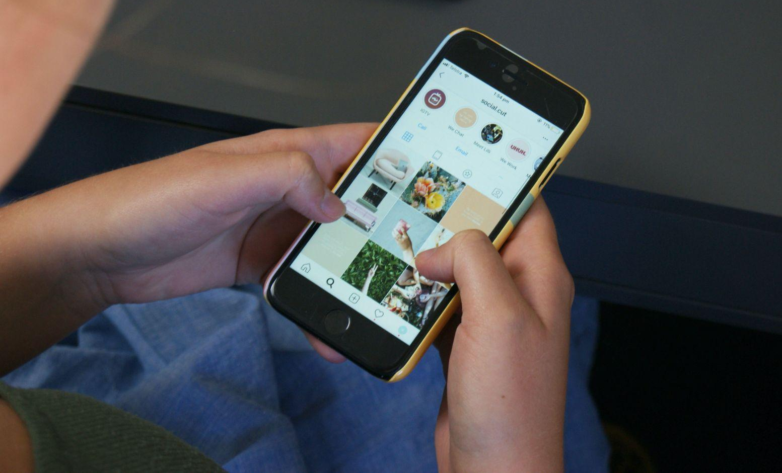
Social media by the numbers: 2021
(5 of 29)
4.2 billion
2 hours
35 minutes
Social media users worldwide
Time spent by an average U.S. user per day
Average time spent by average U.S. user per day
February 28 | PAGE 5
RAISE CENTER
Notes:
The average US teenager can spent 3-9 hours on social media per day.
Facebook, Instagram, and Tiktok lead with the most daily time spent on those channels.

Slide 7
Why do we use social media?(6 of 29)
To keep up with current events To network
To stay in touch with friends and family To share experiences
with others
To find entertainment
February 28, 2022 | PAGE 6
RAISE CENTER

Slide 8
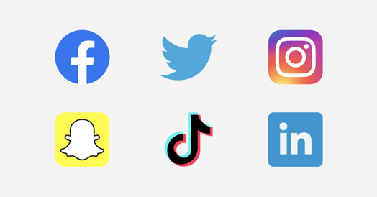
Channel overview (7 of 29)
The core function of any social media networking site is to engage: to post content; to like, comment, share; and to connect with others.
February 28 | PAGE 7
RAISE CENTER
Notes:
There were, of course, several popular social media networking sites between Six Degrees and where we are today. For our purposes, we’ll be skipping over Friendster, Myspace, and others to focus on the big six: Facebook, Twitter, LinkedIn, Instagram, Snapchat, and TikTok.
The core function of any social media networking site is to engage: to post content; to like, comment, share; and to connect with others. While those core functions hold the social media world together, it is interesting to note the differences and unique purposes of each platform.

Slide 9
Facebook (8 of 29)
February 28, 2022 | PAGE 8
RAISE CENTER

Slide 10
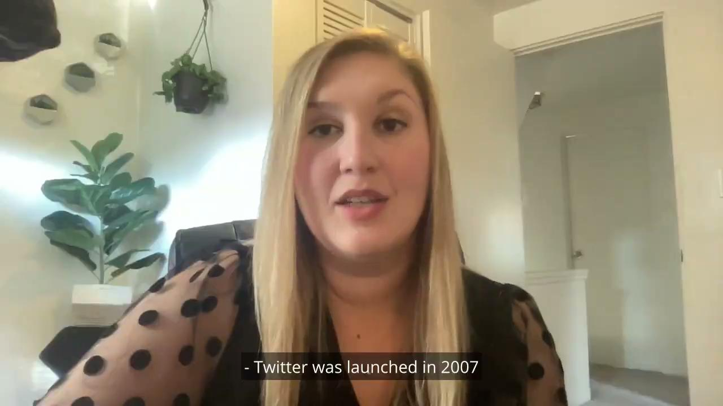
Twitter (9 of 29)
February 28 | PAGE 9
RAISE CENTER

Slide 11
LinkedIn (10 of 29)
INSERT DATE | PAGE 10
RAISE CENTER

Slide 12
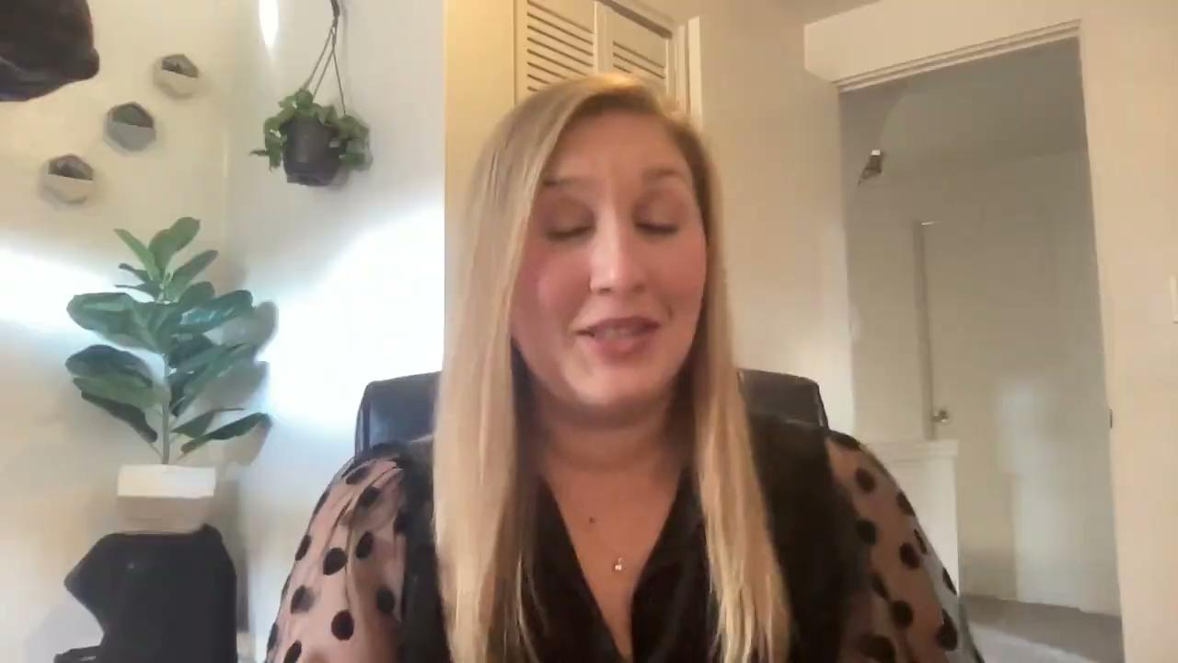
Instagram (11 of 29)
February 28, 2022 | PAGE 11
RAISE CENTER

Slide 13
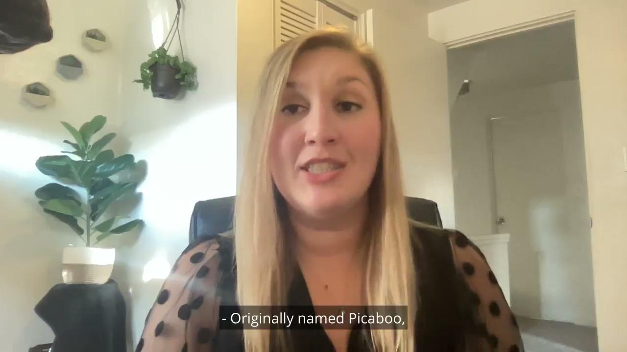
Snapchat (12 of 29)
February 28 | PAGE 12
RAISE CENTER

Slide 14
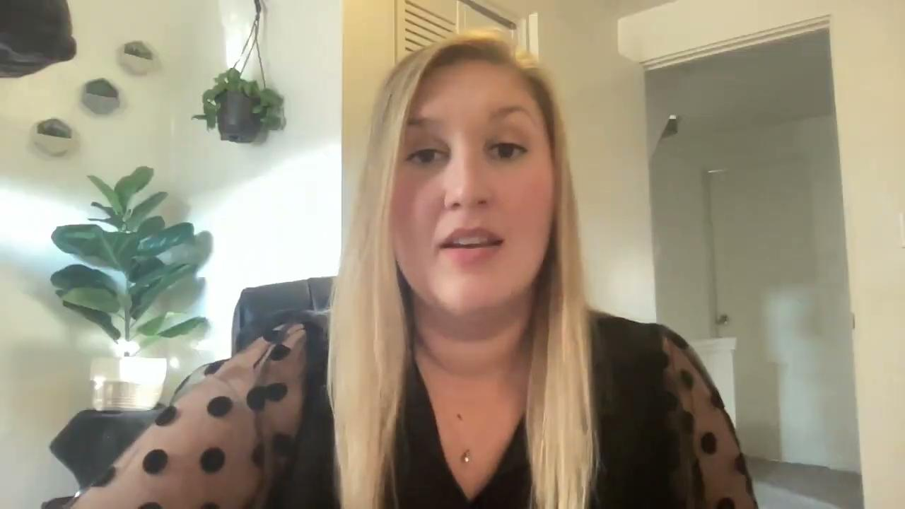
TikTok (13 of 29)
INSERT DATE | PAGE 13
RAISE CENTER

Slide 15
Best practices (14 of 29)
Post regularly Follow trends
Monitor analytics ENGAGE!
Use tools
February 28, 2022 | PAGE 14
RAISE CENTER

Slide 16
Platform accessibility: Facebook (15 of 29)
Keyboard shortcuts Live video and video calling
Screenreaders and assistive Facebook Messenger and Feed guides
technology
Dedicated Accessibility and Assistive
Closed Captions Technology team
Text size and contrast
February 28 | PAGE 15
RAISE CENTER

Slide 17
Platform accessibility: Facebook (16 of 29)
February 28 | PAGE 16
RAISE CENTER

Slide 18
Platform accessibility: Twitter (17 of 29)
Alternative text image descriptions
Screenreaders and assistive voice technology
Accessibility Center for Excellence and Experience Accessibility
February 28 | PAGE 17
RAISE CENTER

Slide 19
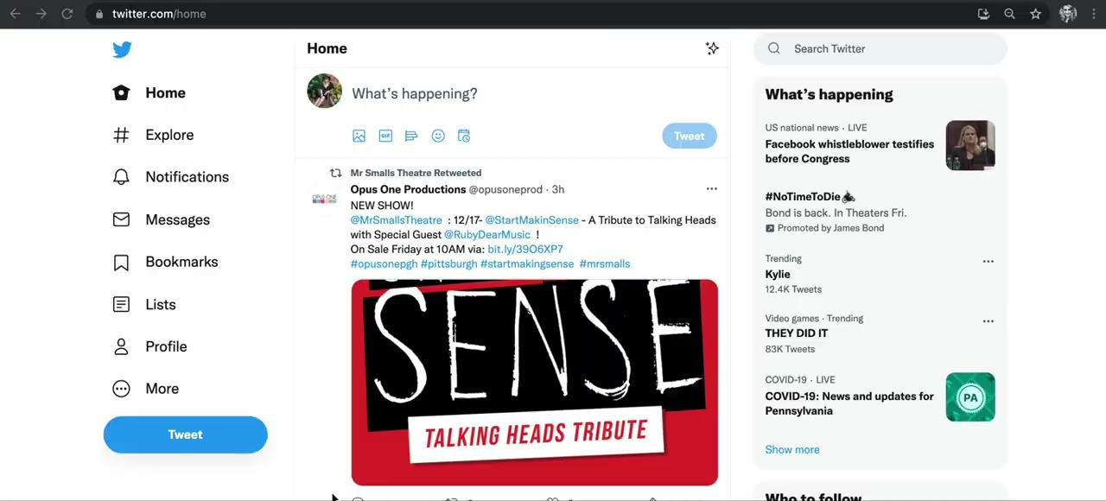
Platform accessibility: Twitter (18 of 29)
February 28 | PAGE 18
RAISE CENTER

Slide 20
Platform accessibility: LinkedIn (19 of 29)
Screenreaders and assistive technology
Disability Answer Desk
Be My Eyes – a free service recommended by LinkedIn that connects blind and low-vision people with volunteers for visual assistance.
INSERT DATE | PAGE 19
RAISE CENTER

Slide 21
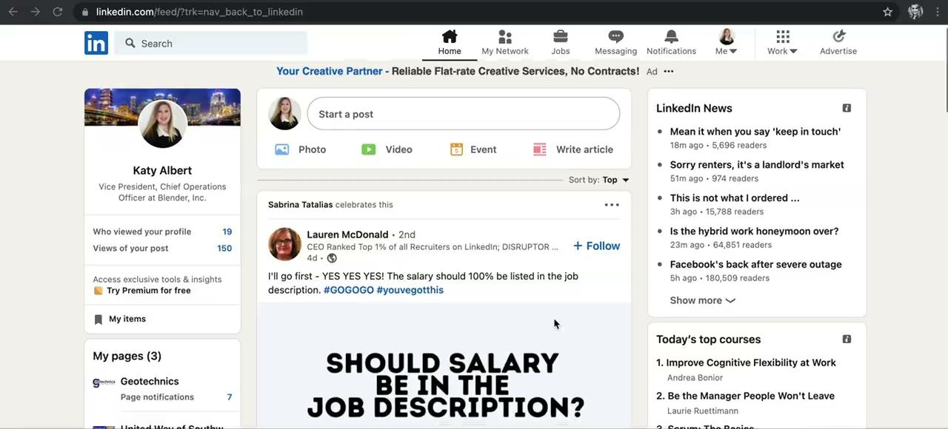
Platform accessibility: LinkedIn (20 of 29)
INSERT DATE | PAGE 20
RAISE CENTER

Slide 22
Platform accessibility: Instagram (21 of 29)
Screenreaders and assistive technology
Text size customization
Live video and video calling
Many features – including publishing – are only available on the app interface.
February 28, 2022 | PAGE 21
RAISE CENTER

Slide 23
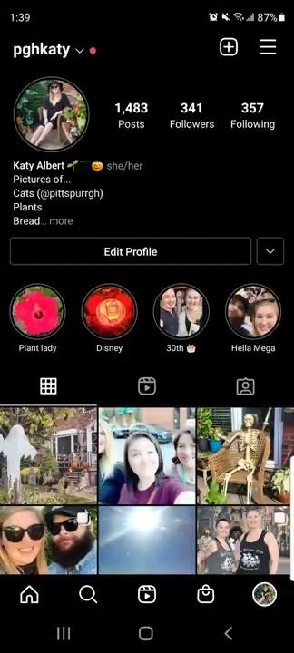
Platform accessibility:
Instagram (22 of 29)
February 28, 2022 | PAGE 22
RAISE CENTER

Slide 24
Platform accessibility: TikTok (23 of 29)
Photosensitive epilepsy warning and opt-out
Text-to-speech
Auto video captions
Many features – including publishing – are only available on the app interface.
February 28 | PAGE 23
RAISE CENTER

Slide 25
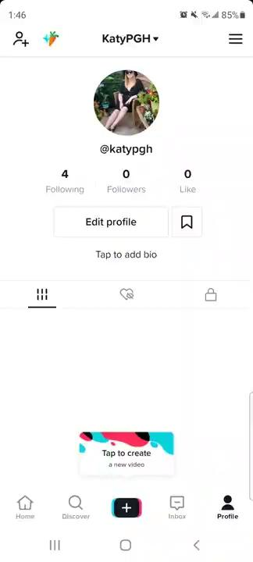
Platform accessibility:
TikTok (24 of 29)
February 28 | PAGE 24
RAISE CENTER

Slide 26
Platform accessibility: Snapchat (25 of 29)
App only interface
Does not currently offer any accessibility tools
February 28 | PAGE 25
RAISE CENTER

Slide 27
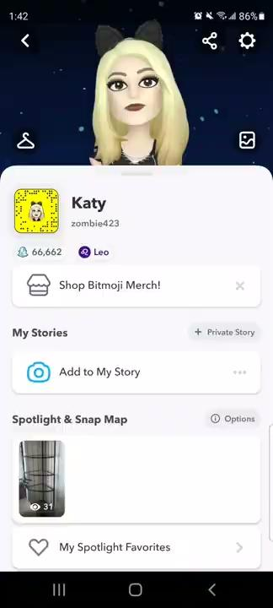
Platform accessibility:
Snapchat (26 of 29)
February 28 | PAGE 26
RAISE CENTER

Slide 28
Best channels for…
(27 of 29)
Building awareness
Educating
Advertising
events
Covering live events
Activating audiences
Facebook
Twitter
LinkedIn
Facebook
Twitter
Instagram
Facebook
Twitter
Twitter
Instagram
Snapchat
TikTok
Facebook
Twitter
Instagram
February 28 | PAGE 27
RAISE CENTER

Slide 29
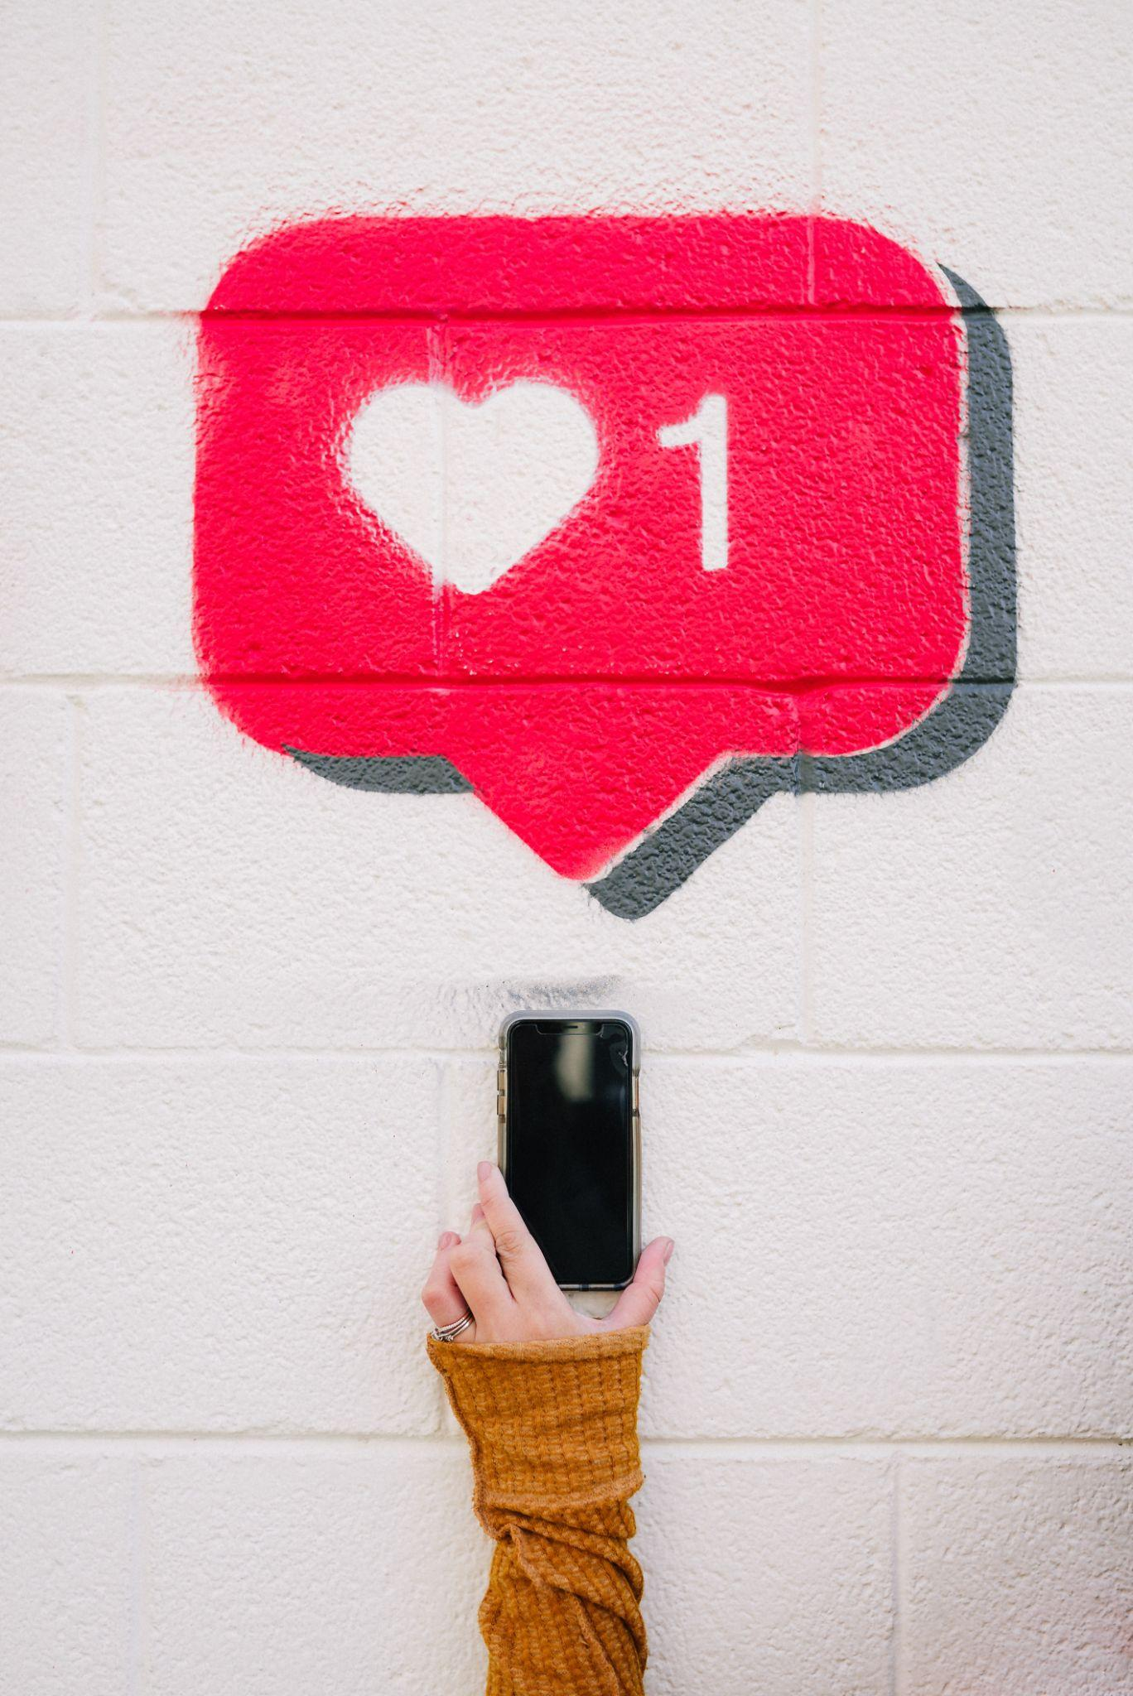
Roadmap to success
(28 of 29)
Create a strategy
Make a schedule
Check yourself
February 28 | PAGE 28
RAISE CENTER
Notes:
Create a strategy
What are your goals? To educate? Activate?
Think about your audience. What channels do they use?
How much time can your team devote to social media?
Make a schedule
Plan your content out by week or month.
Know what you want to promote in advance and have your assets (messages, photos, registration links, etc.) ready to go.
Build in time to monitor your posts and engage with any comments or shares.
Check yourself
After working your strategy for two or three months, examine how it’s going. Are you meeting your goals? Is your audience growing? Are you happy with the results?
If you’re not seeing the desired outcomes, consider changes you could make and implement them into your strategy.

Slide 30
Thank you!
Questions?

Slide 31
Thank You for joining us for this webinar! Please complete our survey
For more information, please contact us at: raisecenter.org
Notes:
[SPEAKER]
● You will get a survey immediately after the webinar is over. Please complete our survey.
Thank you!

