Slide 1
Youth Development & Leadership
Curtis Richards, Director
Jennifer Thomas, Youth Development Specialist
National Collaborative on Workforce and Disability for Youth
Institute for Educational Leadership
http://www.ncwd-youth.info

Slide 2
Objectives
Define youth development and leadership.
Provide examples of youth engagement strategies.
Describe the Youth Action Council on Transition’s (YouthACT) role in youth development and leadership, using the YouthACT model as an example.

Slide 3
National Collaborative on Workforce and Disability for Youth (NCWD/Youth)
Funded by the Department of Labor’s Office of Disability Employment Policy
National Technical Assistance Center
Housed at the Institute for Educational Leadership
Leads the National Youth Action Council on Transition (YouthACT)

Slide 4
Journey Line Activity
Complete the Journey Line of Leadership form.
Pick one experience you documented on the Journey Line of Leadership form, and write a little more about it on a extra large sticky note.
Share the experience you wrote on an extra large sticky note with someone.
Place your extra large sticky note on the Journey Line that is on the wall.

Slide 5
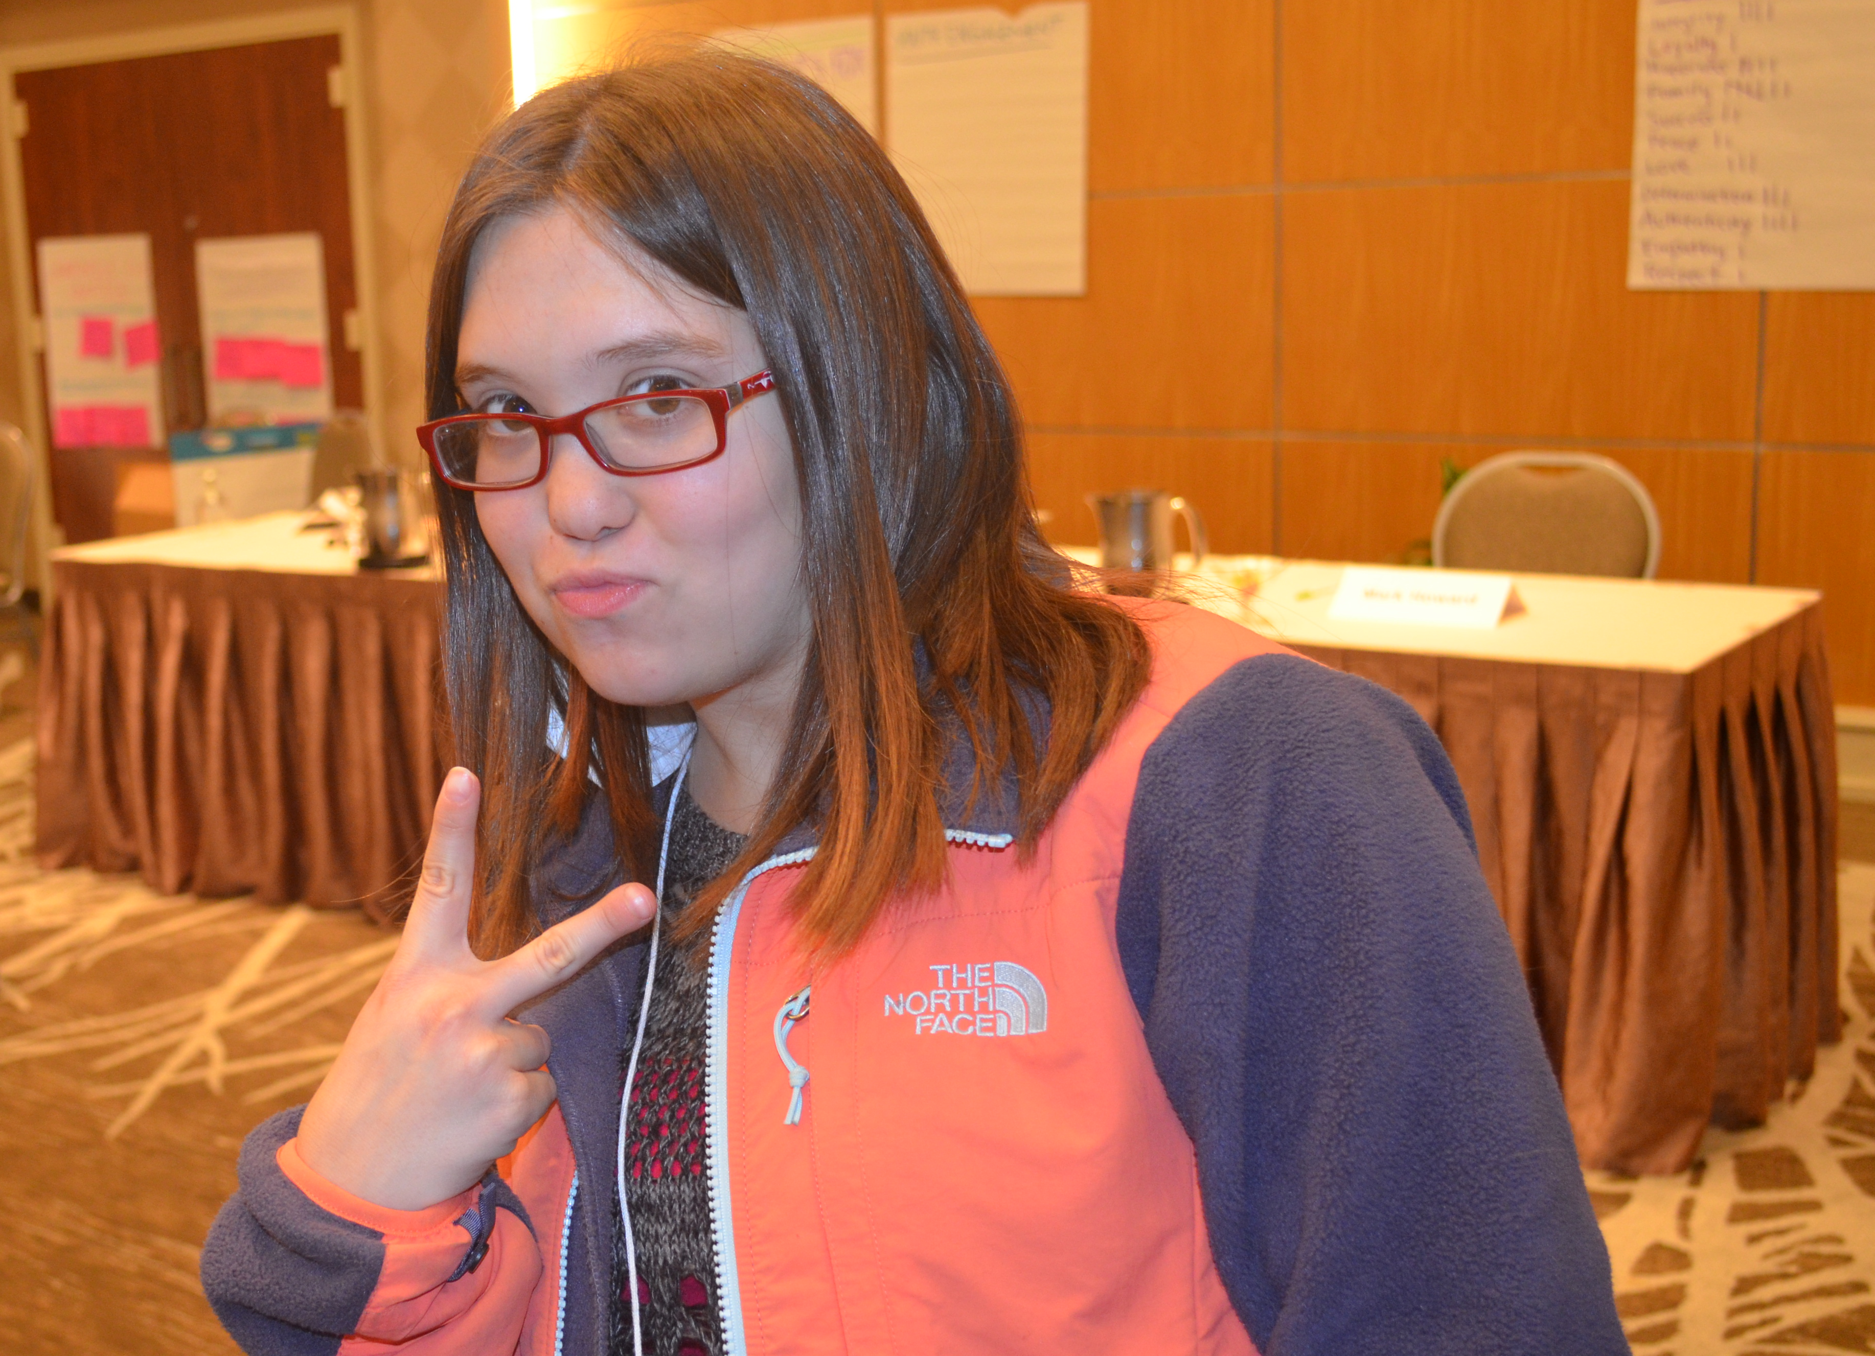
Youth Development vs. Youth Leadership
Youth Development is
Youth Leadership is
a process that prepares young people to meet the challenges of adolescence and adulthood through a coordinated, progressive series of activities and experiences that help them to become socially, morally, emotionally, physically, and cognitively competent.
an important part of the youth development process.
both an internal and an external process leading to
(1) the ability to guide or direct others on a course of action, influence their opinion and behavior, and show the way by going in advance; and
(2) the ability to analyze one’s own strengths and weaknesses, set personal and vocational goals, and develop the self-esteem to carry them out.

Slide 6
Framework for Active Youth Involvement

Slide 7
Youth Action Council on Transition (NCWD/Youth)
The Youth Action Council on Transition (YouthACT) is a national initiative to get more youth with disabilities and their allies involved as leaders who partner with adults and organizations to improve opportunities for youth to succeed in life.

Slide 8
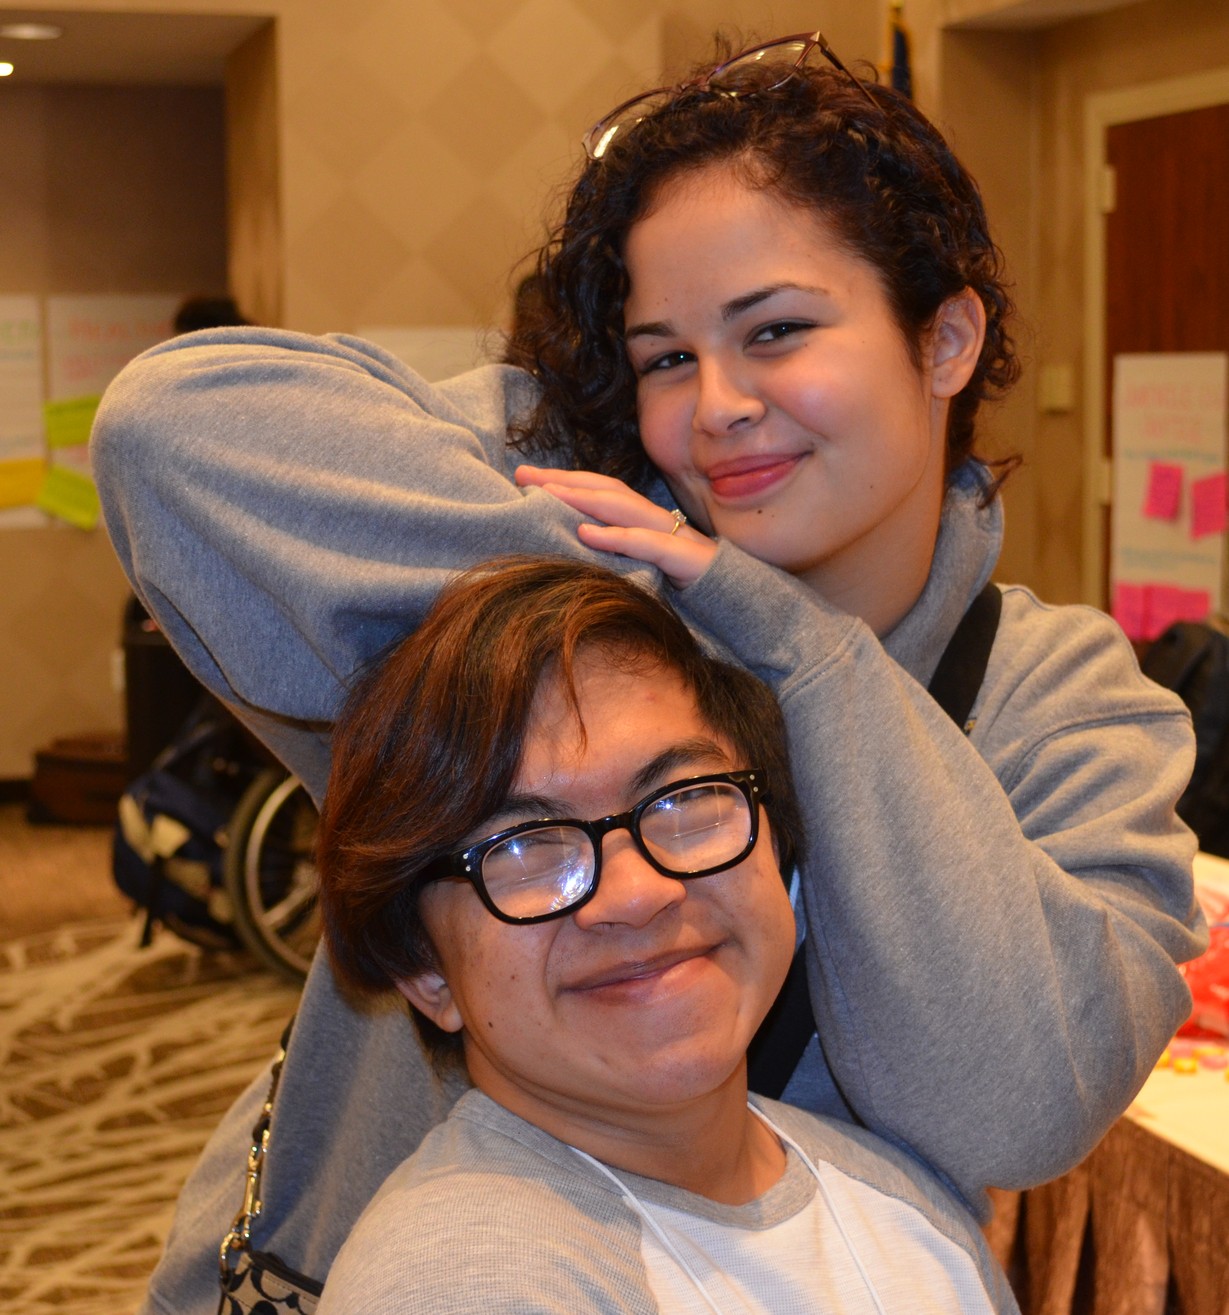
Goal of YouthACT
YouthACT aims to improve the capacity and engagement of youth with disabilities and their allies as leaders and partners in efforts to improve transition policies and practices within and across systems serving youth.

Slide 9
Goal of YouthACT
Youth ACT will accomplish this goal by:
1) Supporting the creation of local YouthACT teams consisting of two emerging youth leaders, one adult partner, and a sponsoring organization.
2) Providing the emerging youth leaders the training and mentoring necessary to increase their knowledge about the transition process and policies in various systems and increase their leadership and advocacy skills.
3) Supporting the youth leaders, as a part of their YouthACT team, to participate in leadership opportunities related to informing their peers and the various systems about improved transition for all youth.
4) Engaging the youth leaders in developing materials and tools for youth, families, professionals, and policy makers.
5) Engaging the youth leaders in identifying transition barriers youth are experiencing across systems.
6) Developing the capacity of organizations/agencies to effectively engage youth as leaders and partners in efforts to improve youth transition outcomes.

Slide 10
Team Structure
Two Youth
One Adult Partner
One Supporting Organization Contact

Slide 11
Considerations for Genuine Youth Engagement
Relationships are important!
Partnering with youth is important!
Avoid patronization, pity, and power.
Incentives are important!
Find ways to implement the feedback youth are share with you and be honest about what your organization is unable to do!
It is just as important that you be accountable to youth as it is that the youth be accountable to you!
Flexibility and supports are VITAL!
Several adjustments may be necessary before things flow smoothly!
While it is important to respect the cultures of the youth you are working with, it is not necessary to attempt to become a youth!
If you mess up, apologize and ask for forgiveness!

Slide 12
Got Fears?
Sustainability
Transportation
Safety
Programming
Knowledge/Experience

Slide 13
So, Where Do You “Stand?”

Slide 14
Questions

Slide 15
NCWD/Youth Resources
National Collaborative on Workforce & Disability for Youth
http://www.ncwd-youth.info
The Guideposts for Success: A Framework for Families
Preparing Youth for Adulthood
http://www.ncwd-youth.info/family-guideposts-information-
brief
Professional Development: Knowledge, Skills, and Abilities
http://www.ncwd-youth.info/youth-service-professionals

Slide 16
NCWD/Youth Resources
Guiding Your Success Tool
http://www.ncwd-youth.info/guiding-your-success
Hitting The Open Road After High School: How to Choose Your
Own Adventure to Success!
http://www.ncwd-youth.info/hitting-the-open-road
By Youth for Youth: Employment
http://www.ncwd-youth.info/by-youth-for-youth-employment

Slide 17
NCWD/Youth Resources
The 411 on Disability Disclosure: A Workbook for Families, Educators, Youth Service Professionals, and Adult Allies Who Care About Youth with Disabilities
http://www.ncwd-youth.info/411-on-disability-
disclosure-for-adults
The 411 on Disability Disclosure: A Workbook for Youth with Disabilities
http://www.ncwd-youth.info/411-on-disability-
disclosure
Cyber Disclosure for Youth with Disabilities
http://www.ncwd-youth.info/cyber-disclosure

Slide 18
Contact Information
Curtis Richards
Jennifer Thomas
Director
E-mail: richardsc@iel.org
Phone: 202-822-8405 x163
Youth Development Specialist
E-mail: thomasj@iel.org
Phone: 202-822-8405 x162

Slide 19
Thank You!

