Slide 1
Technology & Social Media
The webinar will begin shortly.
For Audio:
Dial 1-877-713-0446
Conference code: 101-725-8988
Please mute your computer speakers & phone line during this webinar.
Please use the Chat Box to tell us:
The name of your Parent Center
Your state

Slide 2
A Few Reminders on Webinar Etiquette
Please remember to “mute” your line.
Please feel free to use the “Chat” box for your questions or comments.
You can also “Raise Your Hand” using the icon at the top left.

Slide 3
Technology & Social Media Webinar
Lewis Hall
Director of Communications
#IWantToWork Campaign
Jessica Wilson
Director of Communication & Dissemination
SPAN/CPIR/RAISE

Slide 4
Let’s Be Social: Improving Social Media Practices

Slide 5
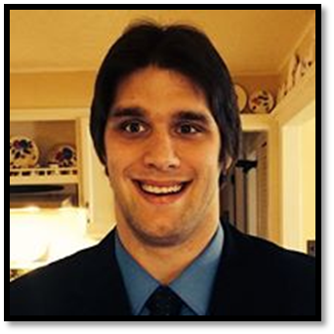
Introduction
Lewis Hall — Media Community Manager / Business Liaison
The #IWantToWork campaign is powered by professional millennials with disabilities. Our self-advocacy and social media campaign focuses on creating and advocating policies that support the employment of people with disabilities at competitive wages in integrated settings.

Slide 6
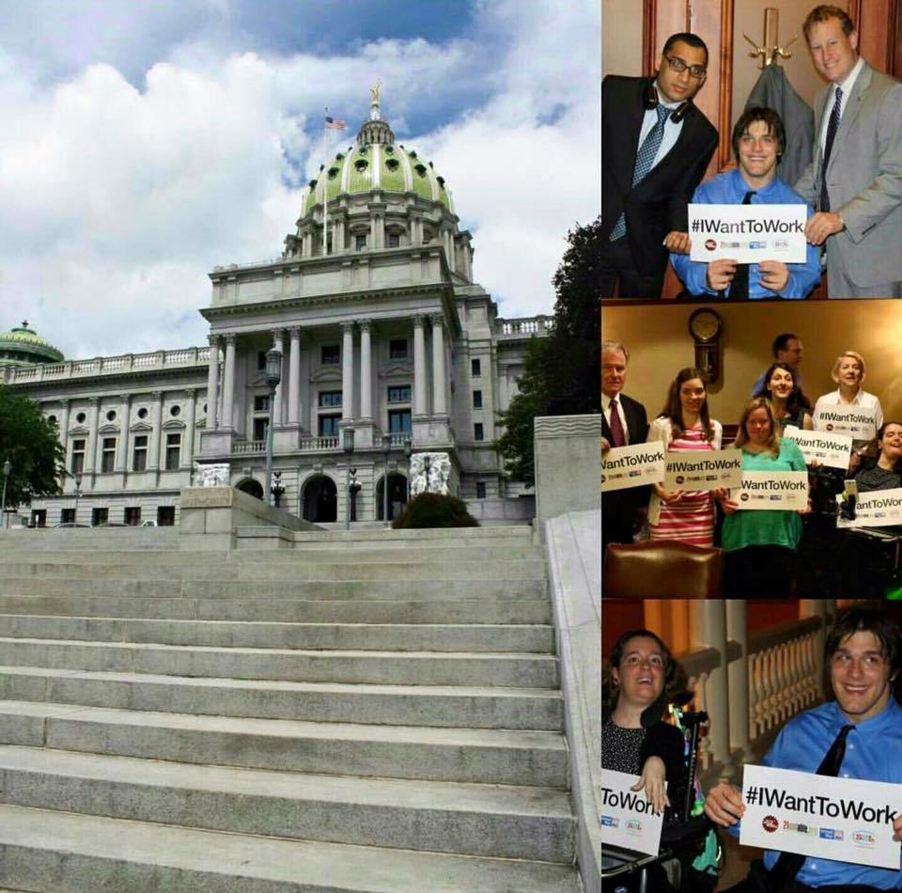
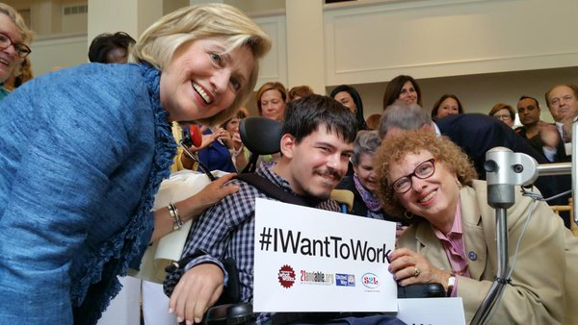
The Selfie Initiative
Call to action of 'take a selfie' was a HUGE part of our success. It’s an easy way to share your support.
We have 375 selfies with legislators and business leaders.

Slide 7
Understanding Metrics
Reach
Post reach is the number of people who have seen your post. Your post counts as reaching someone when it’s shown in their News Feed.
Engagement
People engaged is the number of unique people who’ve clicked, liked, commented on, or shared a post on your page.

Slide 8
Finding Content
Content Curation
Original Content
Grows your audience
Helps your channels become trusted news sources
Opportunity to tag national brands
Stimulates sharing/retweeting
Your followers want to hear what you have to say
Opportunity to position issues in your own voice
Followers will share your content
Original content tends to have more greater engagement

Slide 9
Building a Digital Community
Use channels that align with where your audience is
Research their online habits: Do they use Facebook? Twitter? Instagram? YouTube?
Keep content fresh and interesting
Utilize the newest technology
Facebook Live
Ask for their opinions to optimize channels
Have employees share your message

Slide 10
Improving Content
Use pictures and videos whenever possible
Create hashtags to tie content together
Shorter is better; be as concise as possible
Tease big events
Create ONE simple and direct call to action per message
EX: “Share this post…” or “Call your legislator…”

Slide 11
Creating a Hashtag #
Make sure it hasn’t been used before
Keep it short and sweet
Make it conversational
Can be used for a one time event or long term campaign
Use one relevant to industry
Use “Camel Case”

Slide 12
Management
Respond to messages in a timely manner
Even messages that aren't relevant
Create a form response
Create a content calendar
Keeps you organized
Allows all team members to be on the same page
Be a good social partner
Interact with all retweets/shares
Engage with partner content

Slide 13
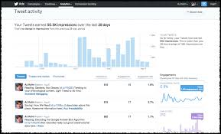
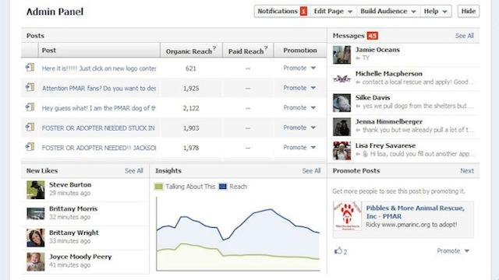
Reviewing Channels
Use Facebook Insights and Twitter Analytics
Paid services are useful to dig deeper
Don’t be afraid to try new things
Vary the frequency and the times of day you post to find the sweet spot for your channels
Create a social media report at least once a quarter
Measure statistics that are meaningful to you (new followers gained, engagement rate, reach, etc.)

Slide 14
Sign on, Like, Re-Tweet, Selfie, Advocate and Join
www.facebook.com/IWantToWorkPA
www.instagram.com/iwanttowork
www.youtube.com/channel/UC3kaBGLmtbvtdijHoBrbd-A
http://www.iwanttoworkpa.org
Notes:
14

Slide 15
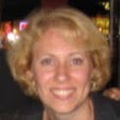
Introduction
Jessica Wilson
Jessica is with Statewide Parent Advocacy Network (SPAN) and works on the RAISE project as well as the CPIR (Center for Parent Information and Resources). She is the loud and proud mother of her son, who has shining brown eyes, a devilish smile, Down syndrome, the energy of a large puppy, and a heart the size of the Grand Canyon.

Slide 16
Social Media Dashboards
How to Manage Your Social Media Marketing

Slide 17
What are Social Media Dashboards?
Programs or websites that let users manage their social media profiles in one grouped location
Many different products available, both free and for a cost

Slide 18
Why would I use a dashboard?
Not necessary to log in to each social media account (Facebook, Instagram, Twitter, Linkedin, Pinterest, etc.) and post separately to each one
Post, update, manage notifications, and more all from one centralized site

Slide 19
What you can do with different products:
Autopost to social media pages and blogs
Autoschedule best time of day to post
Manage posts in calendar views
Generate hashtags
Get sales leads from link posts
Automate Facebook video marketing
Connect data from different channels (social media activities, Facebook ads, Twitter reports, etc.)
#

Slide 20
What are the benefits of using a dashboard?
Much easier for organizations to manage social media
Consolidate your work to one site and schedule multiple posts to your different social media sites
Save Time and Effort

Slide 21
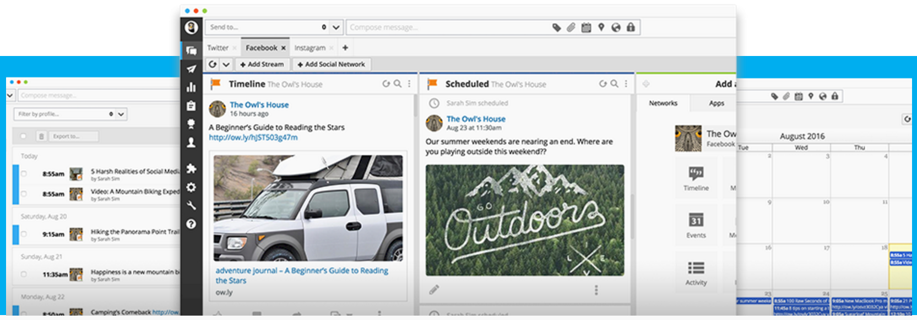
Hootsuite.com

Slide 22
How do I decide?
Two important factors to look for:
Covers all the social media sites your organization uses
Extras such as mobile apps and fee for service*
* We all love free stuff, but if the paid version helps boost your analytics, it could be worth the cost. Don’t ignore paid dashboard services if it brings in a good return on the money you spend.
There are many dashboard products out there.
Each has various perks and problems.
Only you can decide which is the best for your needs.

Slide 23
27 Social Media Dashboards
ArgyleSocial
Buffer
BuzzSumo
CrowdBooster
Cyfe
Dashburst
Dasheroo
Edgerank Checker
Hootsuite
IFTTT (If This Then That)
Keyhole
Klout
NutshellMail
Sendible
SharedCount
Social Mention
Social Oomph
SocialBro
SocialFlow
Sprout Social
SumAll
Tailwind
Tweepi
TweetDeck
Visual.ly’s Facebook Insights
Visual.ly’s Google Analytics Report
Wolfram Alpha Facebook Report

Slide 24
For more descriptions of the listed dashboards:
blog.sumall.com/journal/15-best-free-social-media-dashboards-tools.html
www.jeffbullas.com/2014/09/23/5-top-social-media-dashboard-tools-to-manage-your-social-accounts
blog.dashburst.com/best-social-media-management-tools

Slide 25
Designing for Social Media
Add Some Pizazz to Your Social Media Pages

Slide 26
How can I make my social media more attractive and reflect my organization’s personality?
Images
Images
Images

Slide 27
1
2
3
4
Logo is cut off
Background = dark, bland, impersonal, not to scale
What is RAISE about? ???
Who is the audience? ???
What can you relate to? 0

Slide 28
1
4
2
3
Logo fits box
Background = light, colorful, human, is to scale
What is RAISE about?
Serving youth with disabilities
Who is the audience?
Young people & their families

Slide 29
One Size Does NOT Fit All
* Every social media platform has different cover image measurements

Slide 30
YouTube

Slide 31
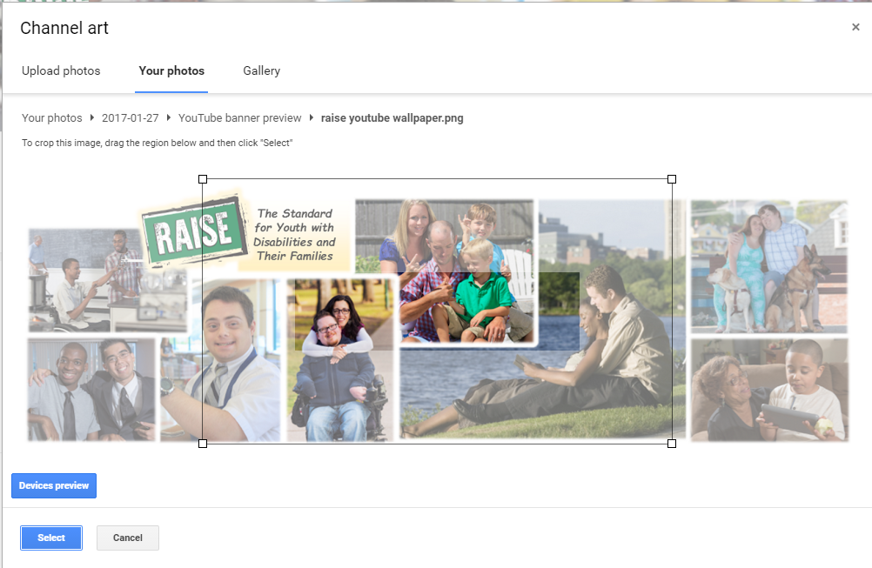
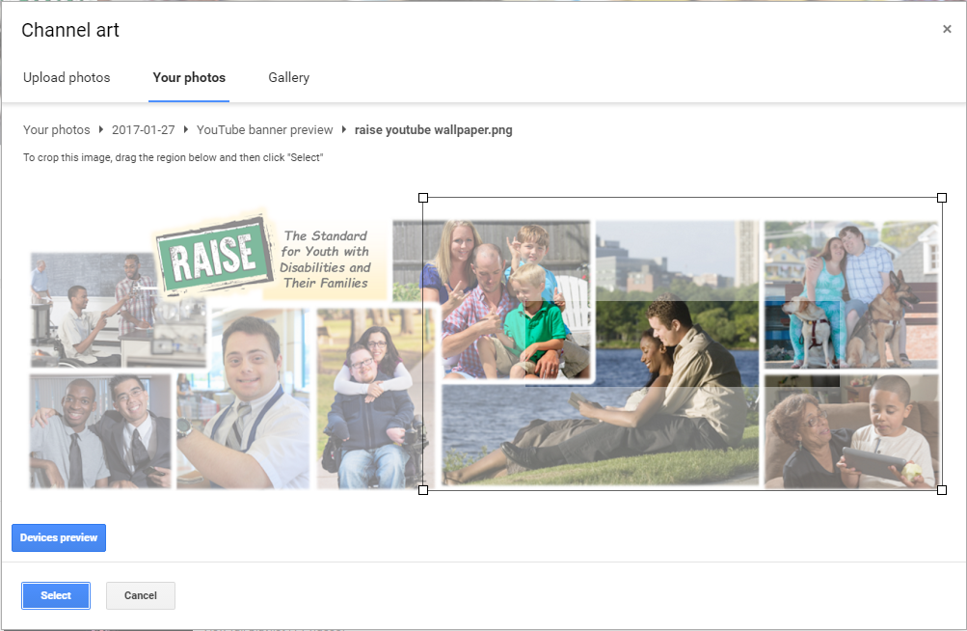
TV
Mobile
TV
Mobile
TV
Mobile

Slide 32
Recommended Image Sizes
851 x 315 pixels
(minimum 339 x 150 pixels)
1080 x 608 pixels
~ Can be up to 2120 x 1192 pixels
~ Smallest image is 480 x 270 pixels
1500 x 500 pixels
1400 x 425 pixels
2560 x 1440 pixels
To convert pixels to inches:
https://www.pixelto.net/px-to-inches-converter

Slide 33
Look for Help Online
There are plenty of guides with great ideas and examples available to search
www.socialmediaexaminer.com/12-creative-ways-to-use-facebook-cover-images-for-business/
www.socialmediaexaminer.com/create-perfect-cover-photo/

Slide 34
Free cover photo templates for
The Essential Cheat Sheet of Cover Photo Dimensions for Facebook, Twitter & More [Templates]
By Lindsay Kolowich @lkolow
blog.hubspot.com/marketing/social-media-cover-photo-sizing-cheat-sheet#sm.0000z3tx8f9hqedrzxb2g2rghvzua

Slide 35
Making Your Facebook Page Accessible
Make photos accessible to people using assistive technology (ex: screen readers, zoom tools, alternate keyboards, etc.)…
Include captions to provide text descriptions for people using assistive technologies
To add a caption to a photo in a new album:
Click “Create Album” and add picture
Type description in “Say something about this photo” window
Click “Add More Photos” or click “Post” to publish
To add a caption to an existing photo:
Open photo and click “Add a Description” to enter text in the window

Slide 36
Automatic Generation of Text
Facebook is enabled for Automatic Alternative Text. Allows users to automatically generate photo descriptions.
Help page: https://www.facebook.com/help/216219865403298?helpref=faq_content
Facebook supports helping users make their pages accessible:
https://www.facebook.com/help/accessibility
https://www.facebook.com/accessibility

Slide 37
Making Your Twitter Page Accessible
https://blog.twitter.com/2016/accessible-images-for-everyone
How to use compose image descriptions option in Twitter app’s accessibility settings:
Add an image to a Tweet
Look for “add description” button in thumbnail
Tap button to add a description (limit = 420 characters)
Instructions for composing image descriptions depending on platform available at https://support.twitter.com/articles/20174660.
Discusses how to enable “Compose image descriptions” setting and instructions for iOS, Android, web, VoiceOver, Talkback, JAWS, and NVDA

Slide 38
Extra, Extra!! BE CAREFUL
Brand Trademark Violations

Slide 39
Altering social media brand identity graphics =
illegal!
You can and will be sued for trademark violations.

Slide 40
Follow the companies’ brand identity guidelines
Provide the rules you should follow
Provide graphics to download for your use
Explain how to refer to their brands in writing
en.facebookbrand.com en.facebookbrand.com/assets/f-logo
brand.twitter.com/en.html
brand.linkedin.com brand.linkedin.com/visual-identity/logo
youtube.com/yt/brand/using-logo.html
developers.google.com/identity/branding-guidelines
https://blog.bufferapp.com/social-media-logos

Slide 41
Thank you
Have fun!
Questions?
lewishall32@gmail.com
jwilson@spannj.org

